Slide 1
Chapter 10
Case studies in
Sequential logic design

Slide 2
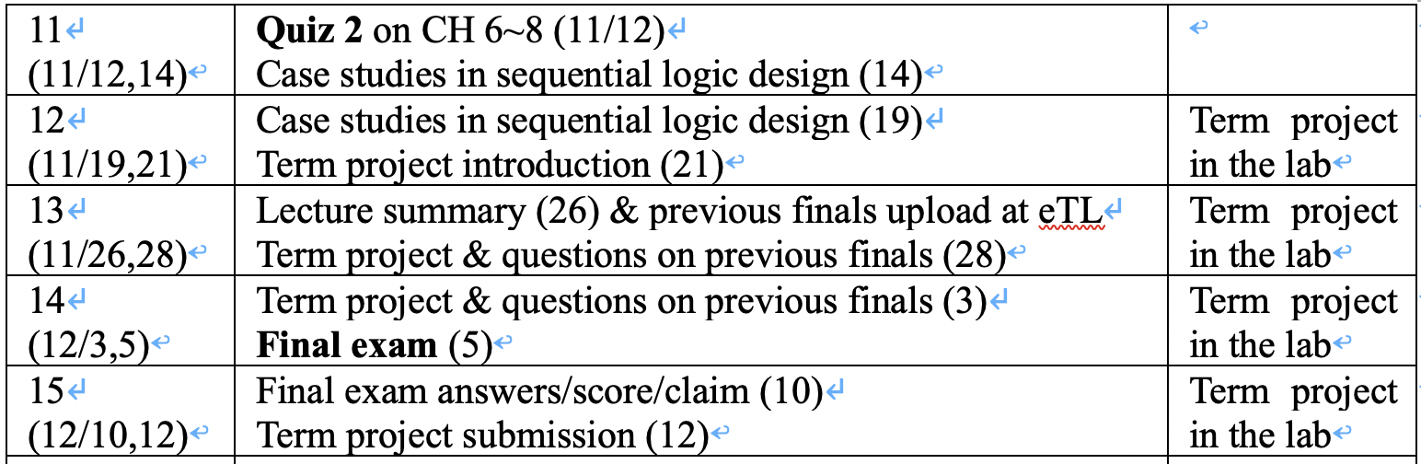
Schedule

Slide 3
FSM Design Examples
Example 1
Scenario A: FSM design from scratch
Scenario B: Utilizing design patterns
Example 2: Design Reuse
Complex counter design by reusing an existing counter
Example 3: Data path + control path
State encoding to simplify control signal generation
Example 4: Memory controller design
Understanding memory architecture and operation details
How to generate pulses at desired time and period?
Memory controller example in detail
Example 5: Multiplier design
Simplifying control logic by modifying data path
Example 6: Serial communication design
Key board → RS232 cable → Display
Designing multiple FSMs running in parallel

Slide 4
Case studies in Sequential Logic Design
Finite String Recognizer
A finite string recognizer has one input (X) and one output (Z).
The output is asserted whenever the input sequence …010…
has been observed, as long as the sequence …100… has not been
seen since the last reset.
Step 1. Understanding the problem statement
Sample input/output behavior:
X: 00101010010…
Z: 00010101000…
X: 11011010010…
Z: 00000001000…

Slide 5
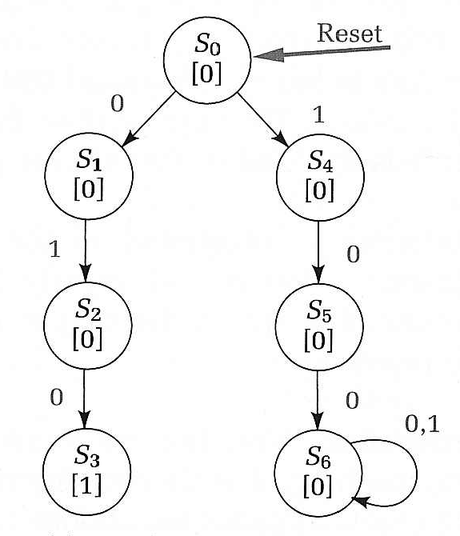
Case studies in Sequential Logic Design
Finite String Recognizer
Step 2. Draw State Diagrams for the strings that must be
recognized. I.e., 010 and 100.
Moore State Diagram
Reset signal places
FSM in S0
Outputs 1
Loops in State

Slide 6
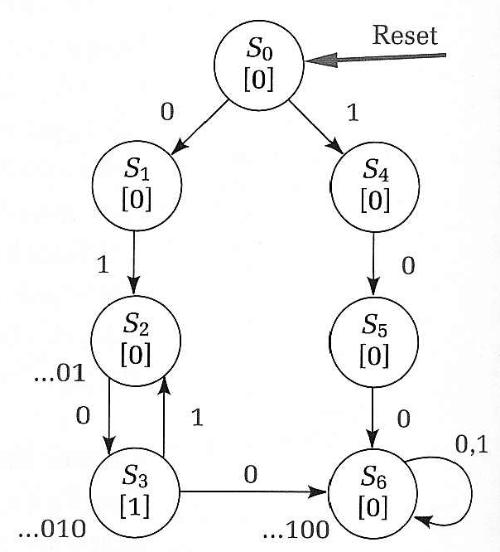
Case studies in Sequential Logic Design
Finite String Recognizer
Exit conditions from state S3:
if next input is 0 then have …0100 (state S6)
if next input is 1 then have …0101 (state S2)

Slide 7
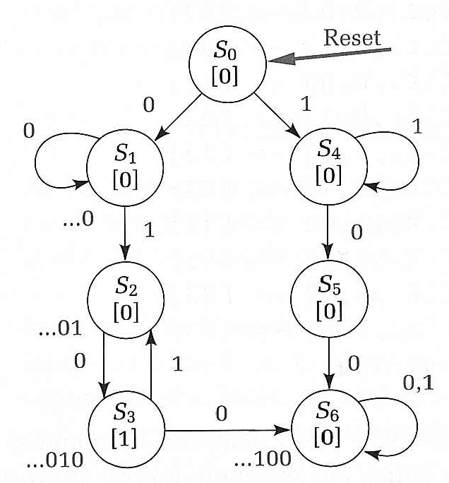
Case studies in Sequential Logic Design
Finite String Recognizer
Exit conditions from S1: recognizes strings of form …0 (no 1 seen)
loop back to S1 if input is 0
Exit conditions from S4: recognizes strings of form …1 (no 0 seen)
loop back to S4 if input is 1

Slide 8
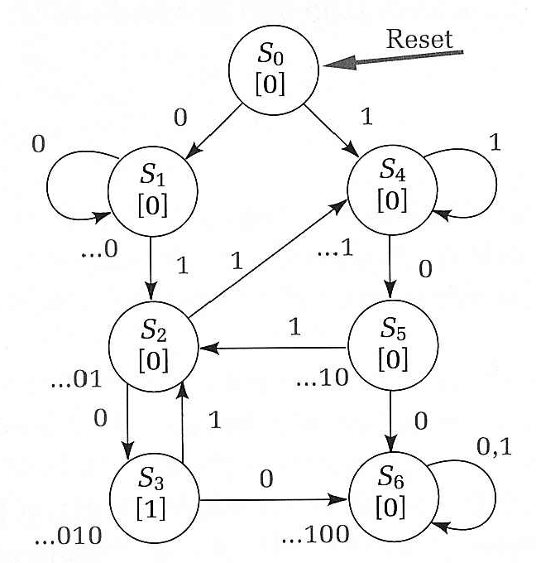
Case studies in Sequential Logic Design
Finite String Recognizer
S2, S5 with incomplete transitions
S2 = …01; If next input is 1, then string could be prefix of (01)1(00)
S4 handles just this case!
S5 = …10; If next input is 1, then string could be prefix of (10)1(0)
S2 handles just this case!
Final State Diagram

Slide 9


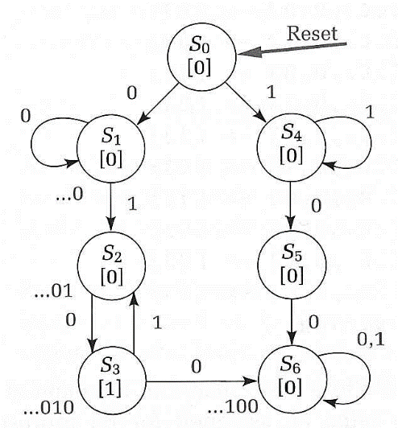

Case studies in Sequential Logic Design
Finite String Recognizer
Review of Process:
1. Write sample inputs and outputs to understand specification
2. Write sequences of states and transitions for the strings
to be recognized
3. Add missing transitions; reuse states as much as possible
4. Verify I/O behavior of your state diagram to insure it functions
like the specification
X: 00101010010…
Z: 00010101000…
X: 11011010010…
Z: 00000001000…

Slide 10
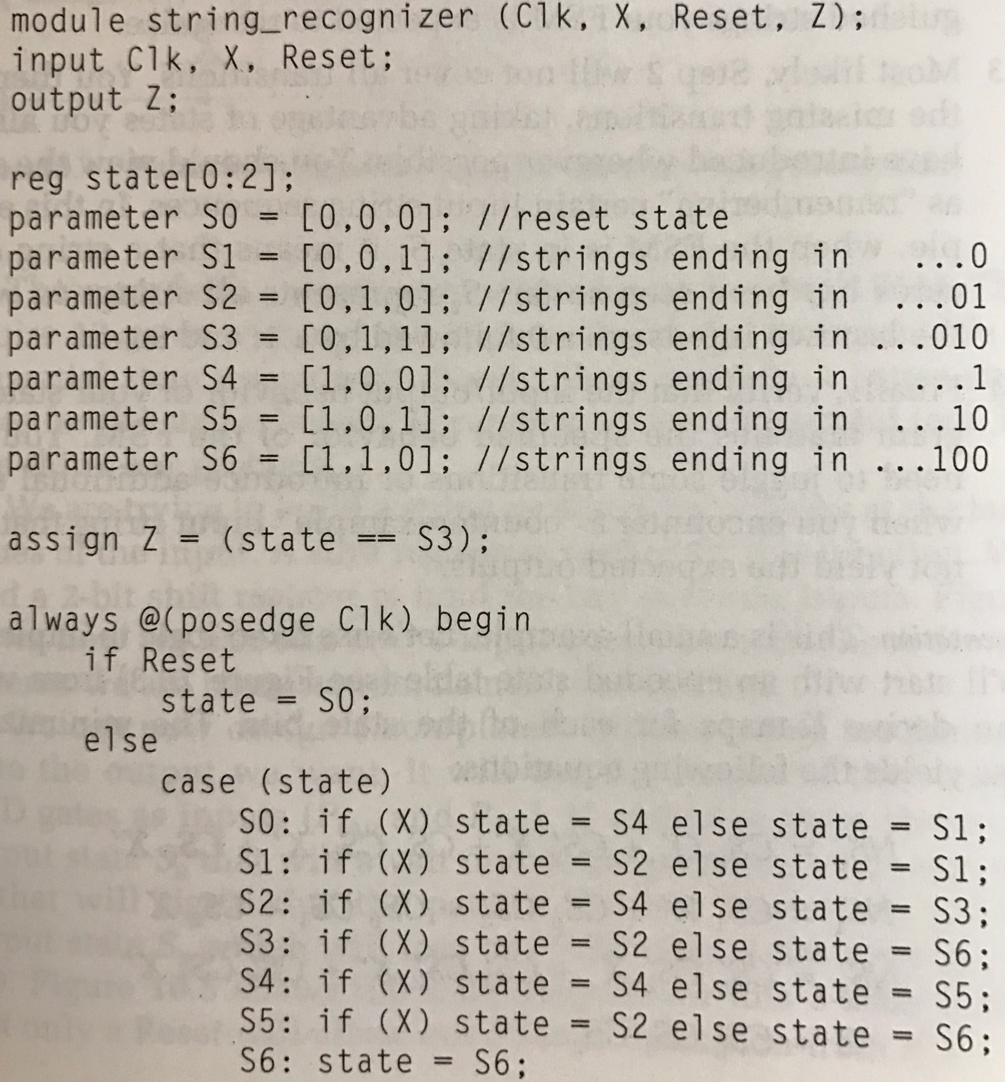
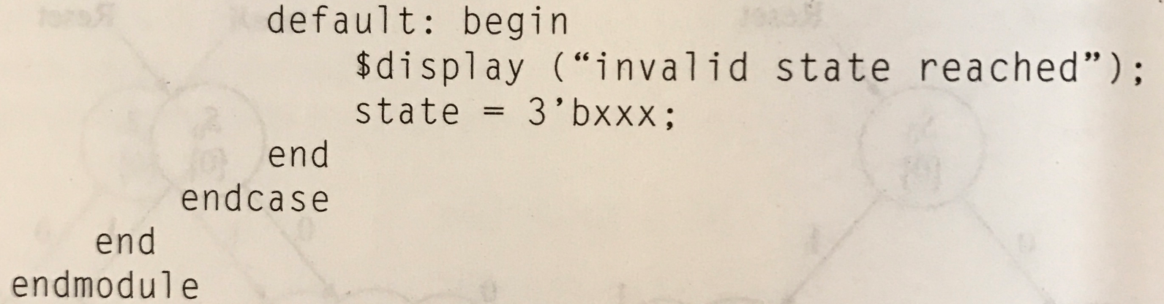
Verilog code

Slide 11
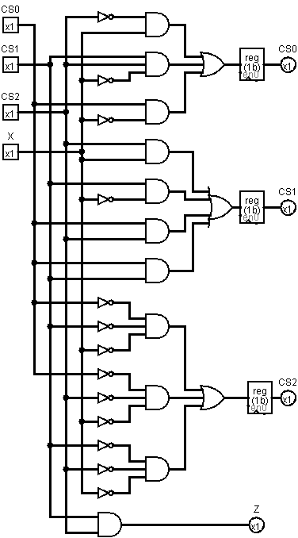
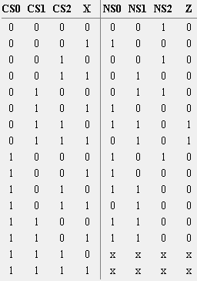
Case studies in Sequential Logic Design
Finite String Recognizer
Implementation:
NS0 = CS2’·X
+ CS1·CS2·X’ + CS0·X’
NS1 = CS2·X + CS1·X’
+ CS0·CS2 + CS0·CS1
NS2 = CS0’·CS1’·X’
+ CS0’·CS2’·X’
+ CS1’·CS2’·X’
Z = CS0’·CS1·CS2
… too complex!

Slide 12
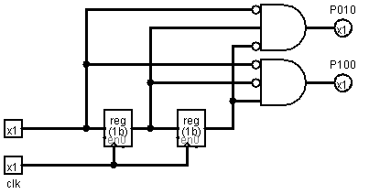
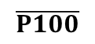
Case studies in Sequential Logic Design
Finite String Recognizer
Implementation: Another approach
Let’s use shift register!
With shift register, we can now design a different state machine
using P010 and P100 as inputs
Reset
S0
[0]
P010
P100
$$\overline{P100}$$
S1
[1]
S2
[0]
P100

Slide 13
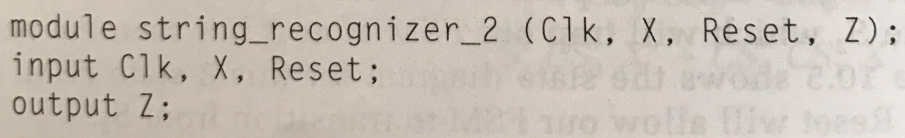
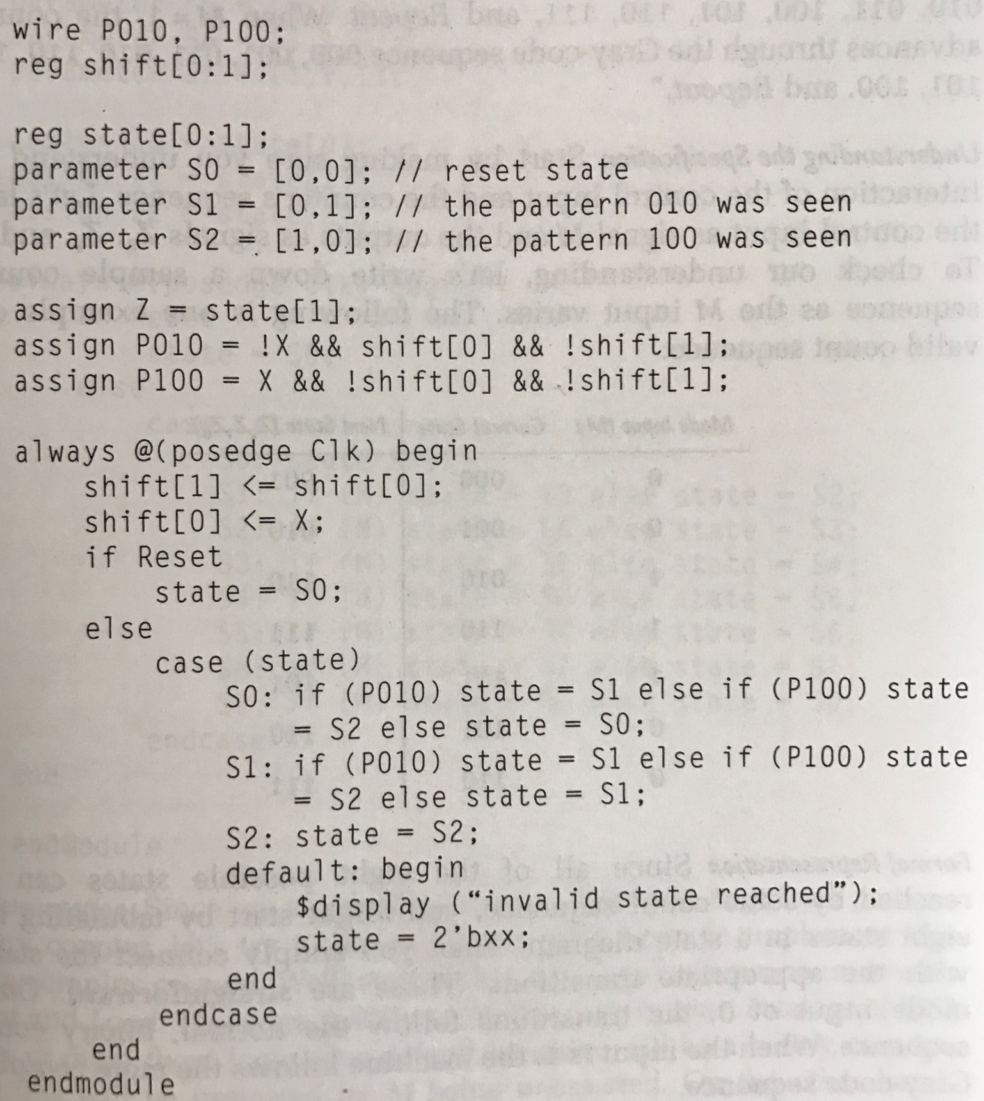
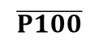
Verilog code
Reset
S0
[0]
P010
P100
$$\overline{P100}$$
S1
[1]
S2
[0]
P100

Slide 14
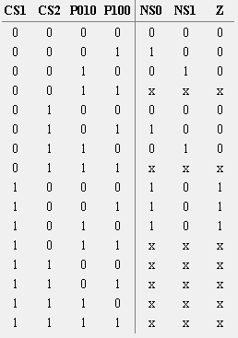
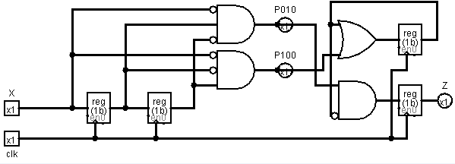
Case studies in Sequential Logic Design
Finite String Recognizer
Implementation: Another approach
NS0 = CS0 + P100
NS1 = CS0’·P010
Z = CS1

Slide 15
FSM Design Examples
Example 1
Scenario A: FSM design from scratch
Scenario B: Utilizing design patterns
Example 2: Design Reuse
Complex counter design by reusing an existing counter
Example 3: Data path + control path
State encoding to simplify control signal generation
Example 4: Memory controller design
Understanding memory architecture and operation details
How to generate pulses at desired time and period?
Memory controller example in detail
Example 5: Multiplier design
Simplifying control logic by modifying data path
Example 6: Serial communication design
Key board → RS232 cable → Display
Designing multiple FSMs running in parallel

Slide 16
Case studies in Sequential Logic Design
Complex Counter
A sync. 3 bit counter has a mode control M. When M = 0, the counter
counts up in the binary sequence. When M = 1, the counter advances
through the Gray code sequence.
Binary: 000, 001, 010, 011, 100, 101, 110, 111, …
Gray: 000, 001, 011, 010, 110, 111, 101, 100, …
One state for each output combination
Add appropriate arcs for the mode control

Slide 17
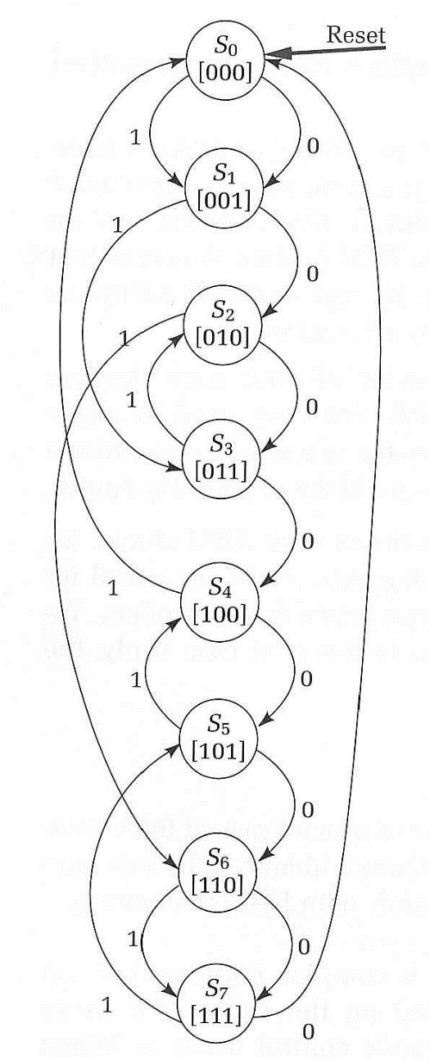
Case studies in Sequential Logic Design
Complex Counter
Current State
000
000
001
001
010
010
011
011
100
100
101
101
110
110
111
111
Mode Input (M)
0
1
0
1
0
1
0
1
0
1
0
1
0
1
0
1
Next State (Z2 Z1 Z0)
001
001
010
011
011
110
100
010
101
000
110
100
111
111
000
101

Slide 18
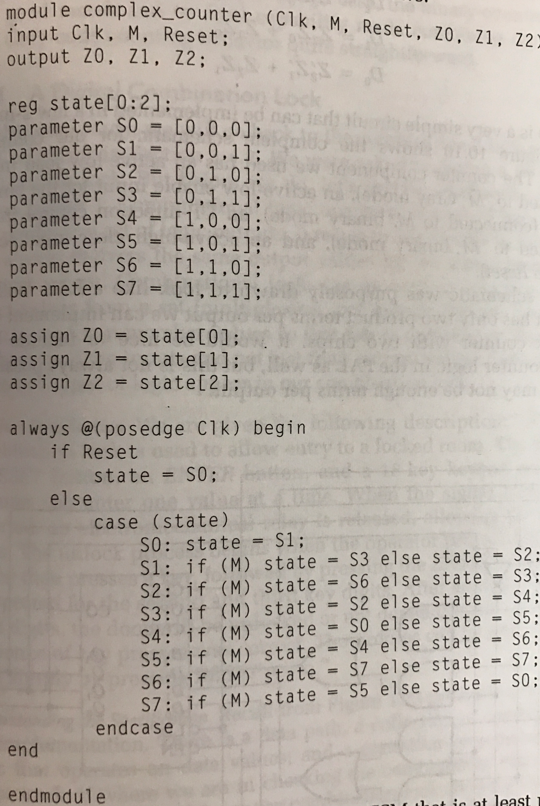
Verilog code

Slide 19
Case studies in Sequential Logic Design
Complex Counter
We’ll implement this Complex Counter using 4-bit sync. counter
To move next Gray-code state, we’ll load these values into counter
when M is asserted.
4-bit sync. counter
Current State
P2 P1 P0
000
001
010
011
100
101
110
111
Next State(Gray)
G2 G1 G0
001
011
110
010
000
100
111
101
EN
UP D C B A
LOAD
CLK
CLR
RCO
QD QC QB QA
G2 = P2·P0 + P1·P0’
G1 = P2’·P0 + P1·P0’
G0 = P2’·P1’ + P2·P1
Counter operates on binary mode when
Up is HIGH
EN is HIGH
Counter loads new inputs
when LOAD is HIGH

Slide 20
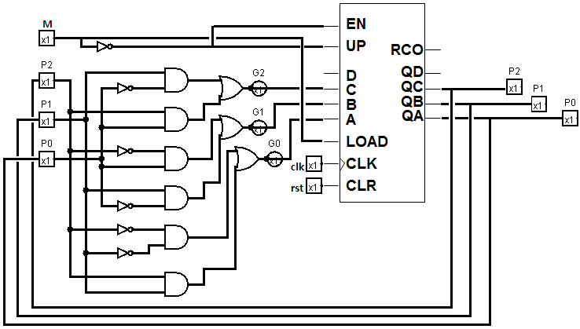
Case studies in Sequential Logic Design
Complex Counter
Complete schematic
G2 = P2·P0 + P1·P0’
G1 = P2’·P0 + P1·P0’
G0 = P2’·P1’ + P2·P1
Counter operates on binary mode when
Up is HIGH(connected to M’)
EN is HIGH(connected to M’)
Counter loads new inputs(operates on Gray mode)
when LOAD is HIGH(connected to M)

Slide 21
FSM Design Examples
Example 1
Scenario A: FSM design from scratch
Scenario B: Utilizing design patterns
Example 2: Design Reuse
Complex counter design by reusing an existing counter
Example 3: Data path + control path
State encoding to simplify control signal generation
Example 4: Memory controller design
Understanding memory architecture and operation details
How to generate pulses at desired time and period?
Memory controller example in detail
Example 5: Multiplier design
Simplifying control logic by modifying data path
Example 6: Serial communication design
Key board → RS232 cable → Display
Designing multiple FSMs running in parallel

Slide 22

Case studies in Sequential Logic Design
Digital Combination Lock
“A 3-digit serial lock controls entry to locked room.
Inputs are RESET, ENTER, and a 16-key keypad, on which the user
can enter one value at a time.
Locks generates an UNLOCK signal when key matches combination.
ERROR light illuminated if key does not match combination.”
To open the door:
Press RESET, (2) enter key for first digit, (3) Press ENTER,
(4) Repeat (2),(3) for second/third digits
E.g., if you type in 139, Press RESET -> Press ‘1’ -> Press ENTER
-> Press ‘3’ -> Press ENTER -> Press ‘7’ -> Press ENTER
If all three key were correct, the door will be opened.
RESET
Inputs:
RESET
ENTER
VALUE (4bit)
(LD1, LD2, LD3)
Operator Data
ENTER
UNLOCK
VALUE
4
Combination
clk
Lock FSM
ERROR
LD1
Outputs:
Unlock
Error
Internal
Combination
C1
LD2
C2
LD3
C3

Slide 23
Case studies in Sequential Logic Design
Digital Combination Lock
State diagram for the combination lock
ERROR
C1!=Value
& ENTER
C3!=Value
& ENTER
C2!=Value
& ENTER
S1
[MUXC1]
S2
[MUXC2]
S3
[MUXC3]
OPEN
[UNLOCK]
Reset
C1==Value
& ENTER
C2==Value
& ENTER
C3==Value
& ENTER
ENTER’
ENTER’
ENTER’

Slide 24

Case studies in Sequential Logic Design
Digital Combination Lock
Block diagram for the combination lock
ENTER
RESET
Datapath
C1
C2
C3
Controller
4
4
4
MUX control
Multiplexer
Controller
4
4
Equal
CLK
VALUE
Comparator
Unlock

Slide 25

Case studies in Sequential Logic Design
Digital Combination Lock
Block diagram for the combination lock
ENTER
RESET
2
0
8
C1
C2
C3
4
4
4
MUX control
Multiplexer
Controller
4
4
Equal
CLK
VALUE
Comparator
Unlock

Slide 26
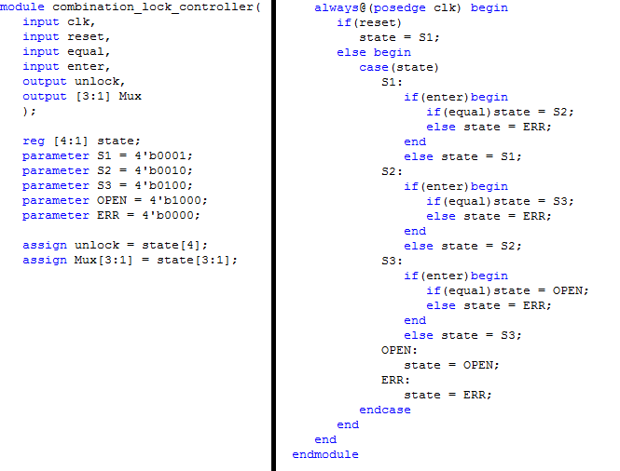
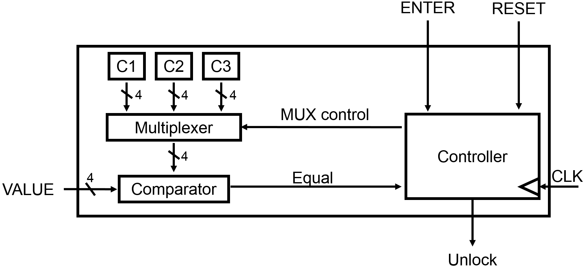
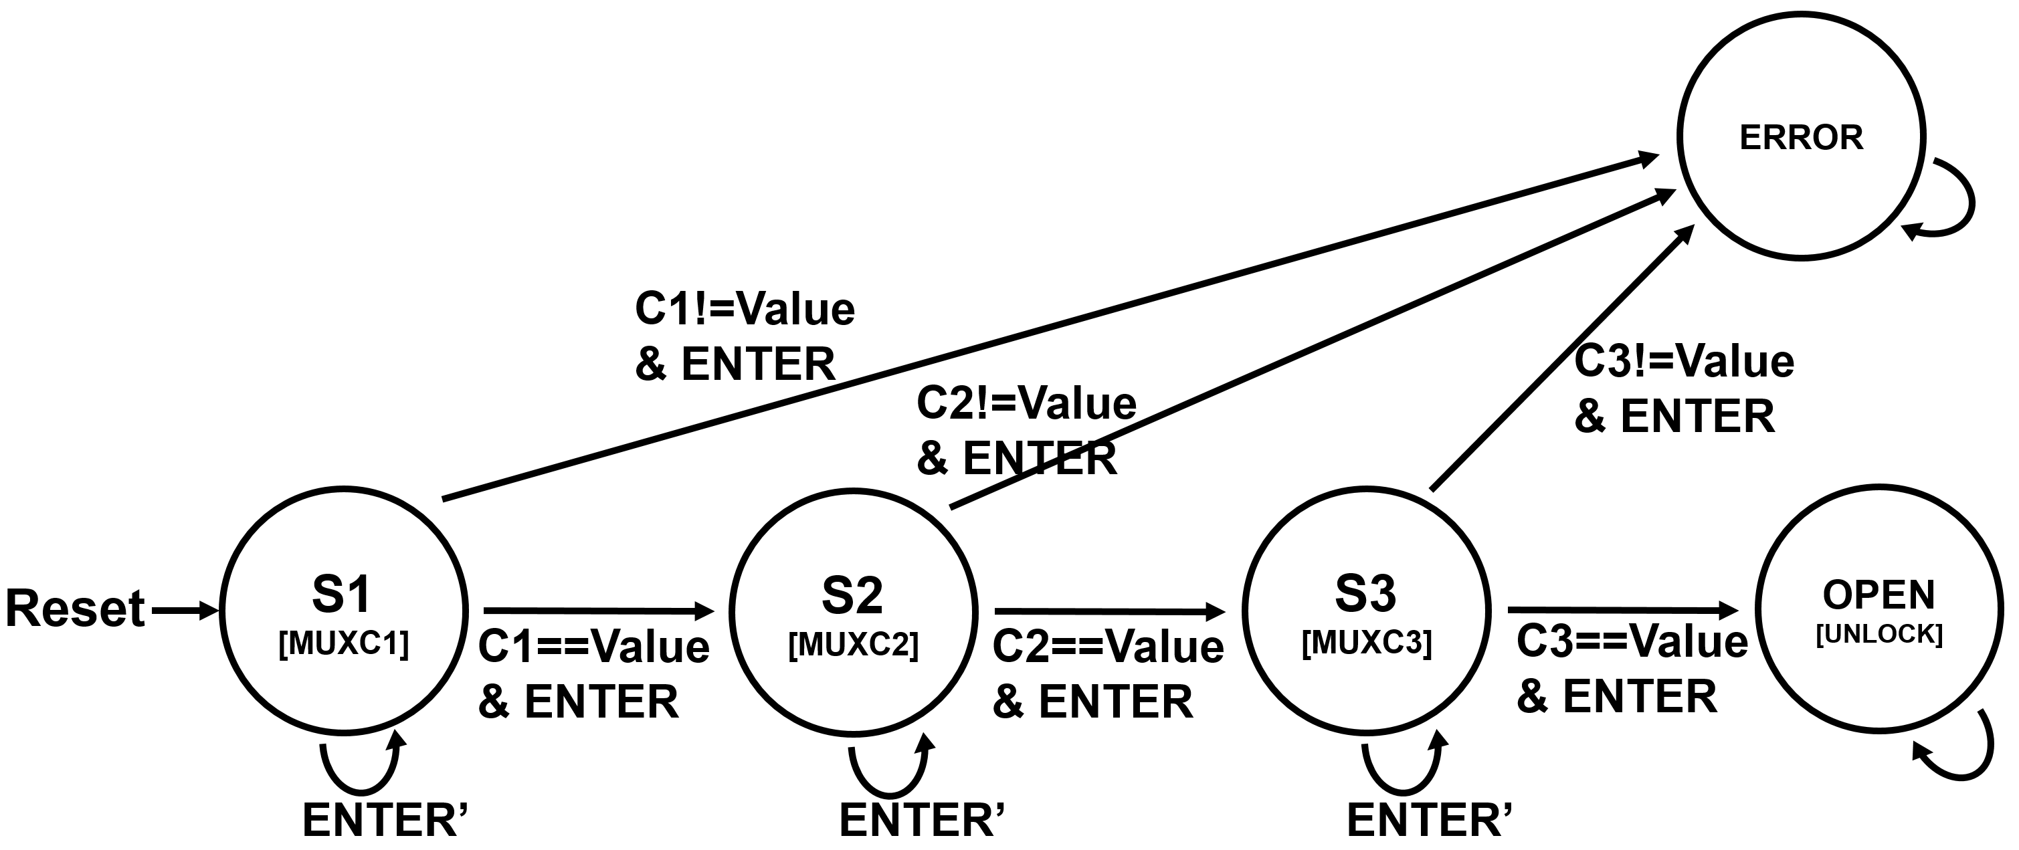


Case studies in Sequential Logic Design
Digital Combination Lock
Controller
Notes:
(다음부터)
구현상 트릭 : 3bit을 안쓰고 4bit을 쓴다.
“State에다가 binary 값을 주는 것을 encoding이라고 하는데 여러가지 choice가 있다.” 의 예제
3bit 써도 되는데, 어떤 방식으로 간단해져서 4bit을 쓴 것.
출력 unlock이 state[4]와 같다.

Slide 27
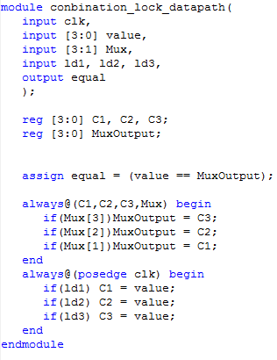
Case studies in Sequential Logic Design
Digital Combination Lock
Datapath
Notes:
(다음슬라이드부터)
내부를 보면, 간단하게 mux동작이다. C1/c2/c3와 mux값을 보는건데,
Mux값이 3이 1이면 C3이다.
equal은 mux아웃이랑 value랑 같은지 체크하고 그게 아웃풋으로 나간다.
(이전으로)

Slide 28
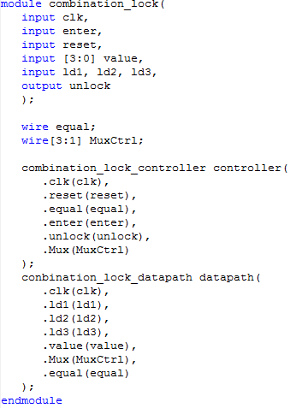
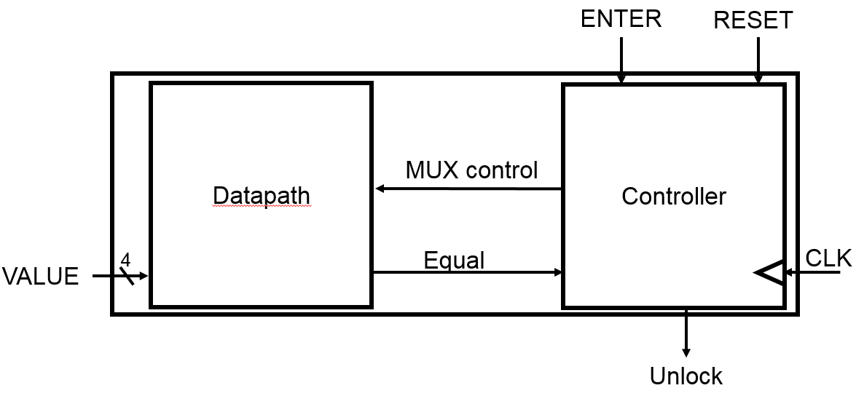
Case studies in Sequential Logic Design
Digital Combination Lock
Top module
Notes:
외부 : Combination lock : 제일 바깥에 있는 밸류의 이름
내부에는 기존에 있는 모듈을 들고 와서 insertion하는 것.
data path는 쉽다.
안에 있는 코드들이 잠깐 스쳐 지나갔던 코드들.
Equal 등 Intermediate들을 사용해야하니까 wire로 선언.
Value가 들어오고 mux con이 들어오고 equal이 나간다.
eqaul도 입력으로 받고, unlock이 나간다.
(이전슬라이드로)

Slide 29
FSM Design Examples
Example 1
Scenario A: FSM design from scratch
Scenario B: Utilizing design patterns
Example 2: Design Reuse
Complex counter design by reusing an existing counter
Example 3: Data path + control path
State encoding to simplify control signal generation
Example 4: Memory controller design
Understanding memory architecture and operation details
How to generate pulses at desired time and period?
Memory controller example in detail
Example 5: Multiplier design
Simplifying control logic by modifying data path
Example 6: Serial communication design
Key board → RS232 cable → Display
Designing multiple FSMs running in parallel
Notes:
6번이 가장 Tricky
READ/WRITE 의 동작이 간단하지 않다.
내 프로그램은 read/write라는 간단한 것을 원한다라고 controller에 주면, con은 memory에게 적당한 timing에 원하는 업무를 할당하도록 ; ex6.

Slide 30
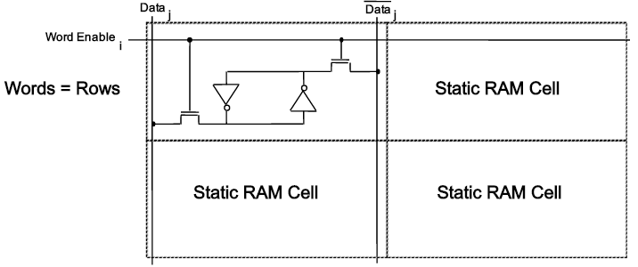

Case studies in Sequential Logic Design
Memory controller
RAM Basics: A 1024 X 4-Bit Static RAM
Static RAM storage elements
Each row of memory cells share a common word enable line.
Each column shares common bit line.
6 transistors for each cell
Why are RAMs efficient in packing many bits into a circuit package?
Only a small number of transistors are needed
It is easy to arrange these elements into rows and columns.
Static RAMs are the fastest memories!
Notes:
S-RAM은 Latch, 인버터 두개 맞물려 놓은 것.
이것만 가지곤, 들고는 있을 수 있지만, 쓸 수는 없다.
이것을 가능하게 하려고 한 것이 R-S Latch.
위 원이 연결되면 강제로 써진다. 0이 있었는데 1 쓰고 싶다, 하면 윗부분을 1로 만든 다음 켜면 버티다가 1이 들어간다.
저 위의 인버터로 둘러 쌓인 것이 한 단위, 1bit을 저장한다.
1개의 라인에 수백개가 붙어있다. 위의 예시로 1, 0으로 배정한 라인.
읽을 때는 어떤 값을 줄까? 읽다가 값을 바꿔버리면 큰일이기 때문에, 중간되는 voltage를 만들어놓은 다음 쓰는 녀석이 발을(접합부) 들고 있다.
그런 후, 0v는 0.5v보다 작고 1v는 0.5v보다 크다. 이를 증폭기가 받아가서 0/1v로 바꾸어서 가져간다.

Slide 31
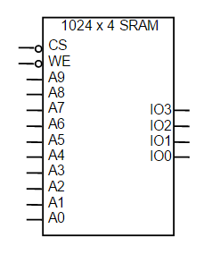
Case studies in Sequential Logic Design
Memory controller
RAM Basics: A 1024 X 4-Bit Static RAM
Pin-out of the 1024 X 4-bit SRAM
to address
1024 (2¹⁰) words
4-bit word
Bidirectional (read/write) I/O

Slide 32
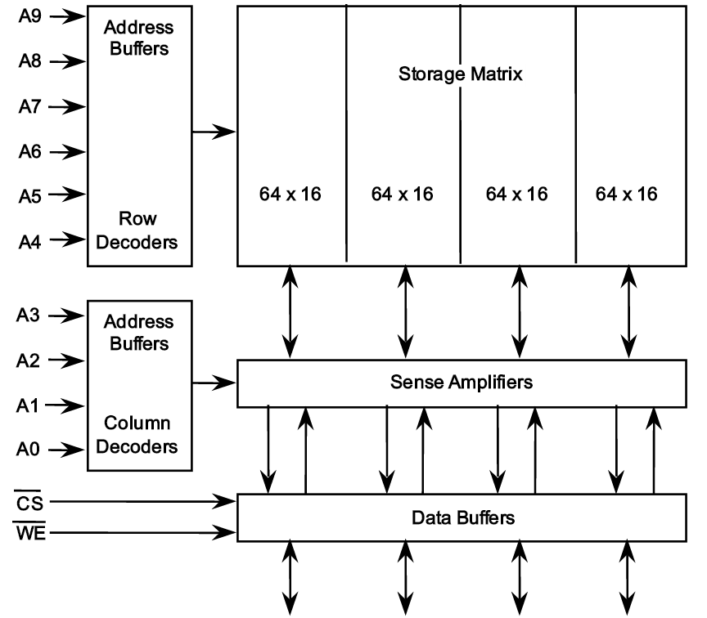
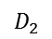
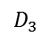
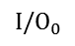
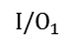

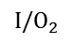
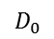
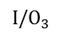
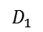
Case studies in Sequential Logic Design
Memory controller
RAM Basics: A 1024 X 4-Bit Static RAM
Internal block diagram
cv
Note that a word’s bits are not stored next to each other but are inter-leaved across the four banks.
64
cv
O0
O1
16
16
16
16
16
O2
$$D_{0}$$
$$D_{1}$$
$$D_{2}$$
$$D_{3}$$
O3
S1
S0
$${I/O}_{0}$$
$${I/O}_{1}$$
$${I/O}_{2}$$
$${I/O}_{3}$$
2:4 decoder

Slide 33
Case studies in Sequential Logic Design
Memory controller
RAM Basics: A 1024 X 4-Bit Static RAM
Internal block diagram
cv
6 address signals select one of 64 rows
64
16
16
16
16
16
$$D_{0}$$
$$D_{1}$$
$$D_{2}$$
$$D_{3}$$
$${I/O}_{0}$$
$${I/O}_{1}$$
$${I/O}_{2}$$
$${I/O}_{3}$$
Notes:
위는 Row address, 아래는 Column address
예전에 Dram은 pin이 비싸서 10개를 안쓰고 한 6개만 쓰고 싶어서, 한번에 안쓰고 두 단계로 나눠서 address를 주도록 명시적으로 만든 것이 DRAM.
SRAM의 경우에는 쓸데없이 복잡하게 됨. 위의 A0~A9의 signal이 칩 안에 있는 signal이므로 모순될 수는 있지만, 핀이 싸기 때문에 위 방식으로 설계되지 않았다.

Slide 34
Case studies in Sequential Logic Design
Memory controller
RAM Basics: A 1024 X 4-Bit Static RAM
Internal block diagram
64
16
16
16
16
Sense amplifier reads all the data of the selected (i.e., activated) row
64 bits are read in this example
16
$$D_{0}$$
$$D_{1}$$
$$D_{2}$$
$$D_{3}$$
$${I/O}_{0}$$
$${I/O}_{1}$$
$${I/O}_{2}$$
$${I/O}_{3}$$

Slide 35
Case studies in Sequential Logic Design
Memory controller
RAM Basics: A 1024 X 4-Bit Static RAM
Internal block diagram
64
cv
16
16
16
16
4 address signals select some of the row data, e.g., 1 of 16 bits, i.e., 4 bits in this example
16
$$D_{0}$$
$$D_{1}$$
$$D_{2}$$
$$D_{3}$$
$${I/O}_{0}$$
$${I/O}_{1}$$
$${I/O}_{2}$$
$${I/O}_{3}$$

Slide 36
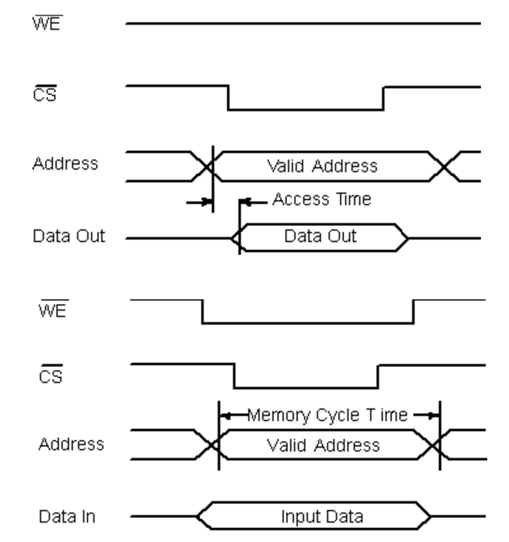
Case studies in Sequential Logic Design
Memory controller
RAM Basics: A 1024 X 4-Bit Static RAM
Simplified Read-Cycle and Write-Cycle Timing
Memory Access Time: the time from address to output
Memory Cycle Time: the time between subsequent memory operations
Access Time ≤ Memory Cycle Time
Read cycle logical sequencing
Write cycle logical sequencing

Slide 37
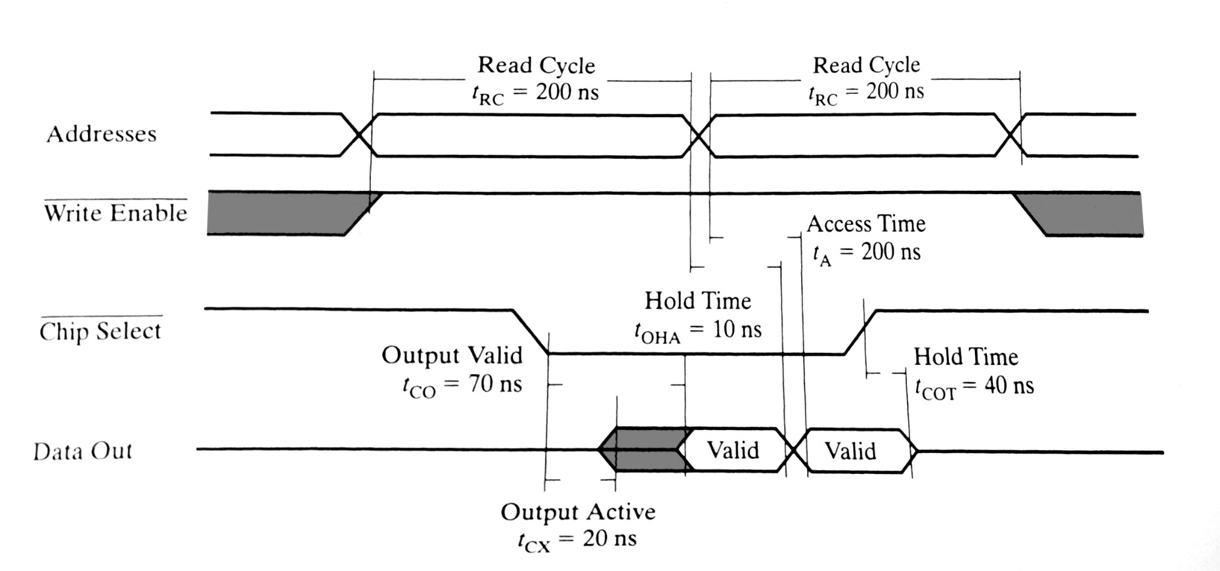
Case studies in Sequential Logic Design
Memory controller
Detailed SRAM Timing
Read cycle timing for an SRAM chip

Slide 38
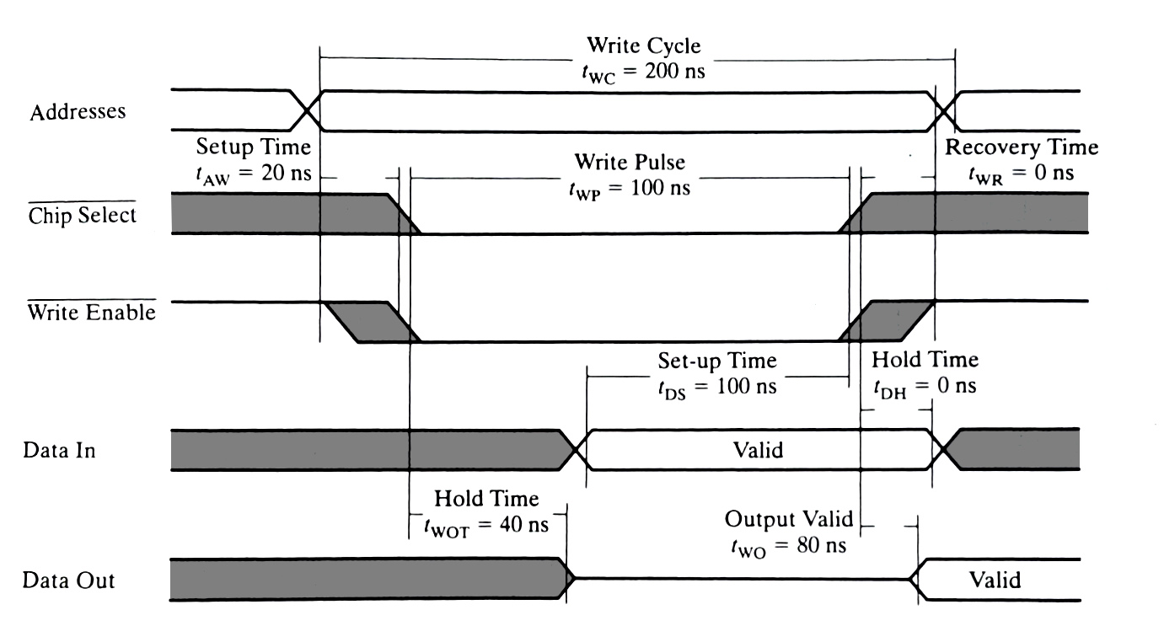
Case studies in Sequential Logic Design
Memory controller
Detailed SRAM Timing
Write cycle timing for an SRAM chip

Slide 39
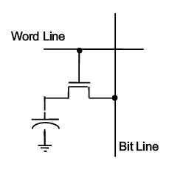
Case studies in Sequential Logic Design
Memory controller
Dynamic RAM
Dynamic RAMs – the densest memories
One-transistor (1-T) memory cell
Issues in DRAM
Small signal and destructive read operation → Sense amplifier is utilized!
Contents of DRAMs decay over time → DRAM cells must be refreshed!

Slide 40
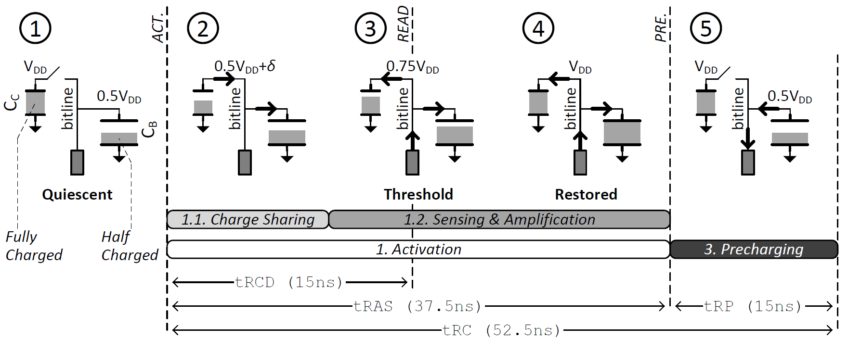


DRAM: Activation and Precharge
[Lee, 2013]
Assuming C_{BL} = 3.5C_{cell}

Slide 41
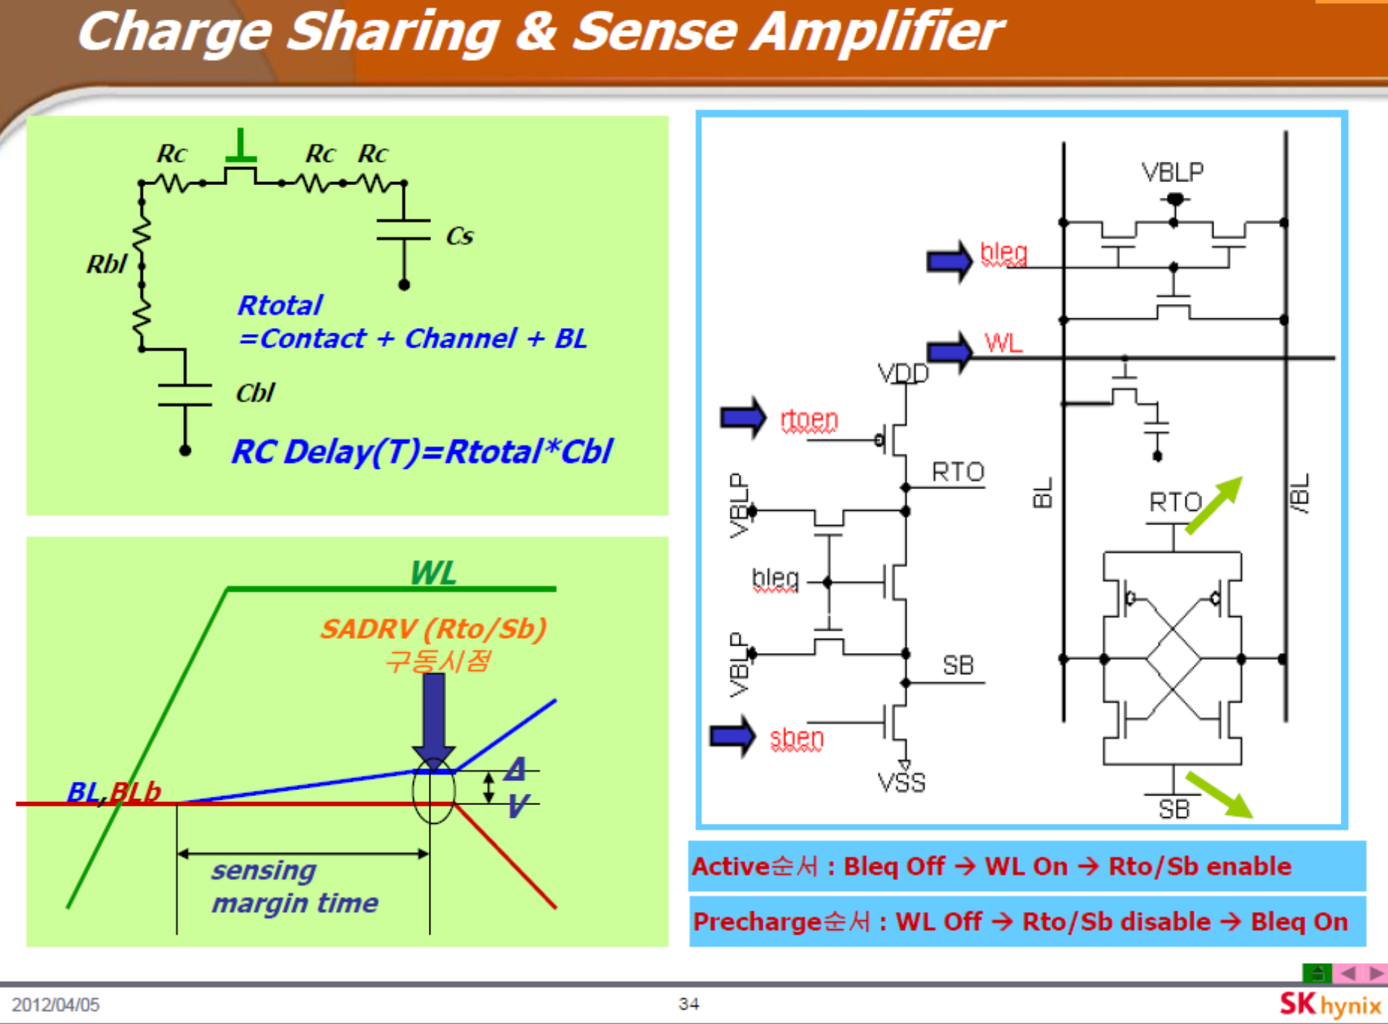

Slide 42
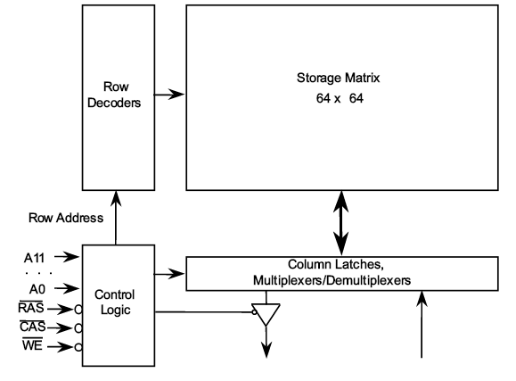


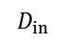
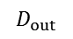

Case studies in Sequential Logic Design
Memory controller
Dynamic RAM
4096 X 1-bit DRAM block diagram
cv
Row address selects one of 64 rows
1 row contains 64 bits in this case
Column Address &
Control Signals
$$D_{out}$$
$$D_{in}$$

Slide 43
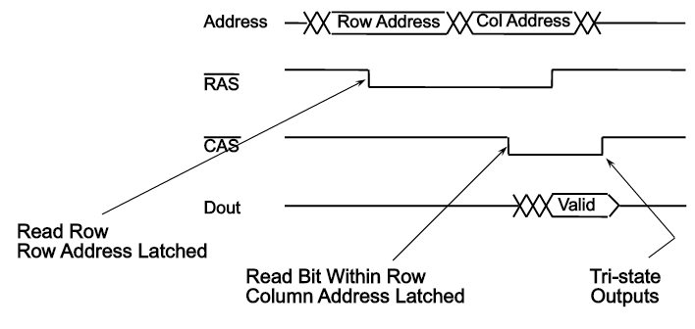
Case studies in Sequential Logic Design
Memory controller
Dynamic RAM
RAS/CAS sequencing for a memory read
The key of rapid access to DRAM is to provide separate control lines for DRAM row access, RAS (row address strobe) and column access, CAS (column address strobe)

Slide 44
Case studies in Sequential Logic Design
Memory controller
Dynamic RAM
4096 X 1-bit DRAM block diagram
cv
Column Address &
Control Signals
Sense amplifier reads the data of the selected row
$$D_{out}$$
$$D_{in}$$

Slide 45
DRAM: Activation and Precharge
[Lee, 2013]
Assuming C_{BL} = 3.5C_{cell}

Slide 46
Case studies in Sequential Logic Design
Memory controller
Dynamic RAM
RAS/CAS sequencing for a memory read
The key of rapid access to DRAM is to provide separate control lines for DRAM row access, RAS (row address strobe) and column access, CAS (column address strobe)

Slide 47
DRAM: Activation and Precharge
[Lee, 2013]
Assuming C_{BL} = 3.5C_{cell}

Slide 48
Case studies in Sequential Logic Design
Memory controller
Dynamic RAM
4096 X 1-bit DRAM block diagram
Refresh = read + precharge
Each row is refreshed every 64 ms
Column Address &
Control Signals
$$D_{out}$$
$$D_{in}$$

Slide 49
Case studies in Sequential Logic Design
Memory controller
Dynamic RAM
RAS/CAS sequencing for a memory read
The key of rapid access to DRAM is to provide separate control lines for DRAM row access, RAS (row address strobe) and column access, CAS (column address strobe)

Slide 50
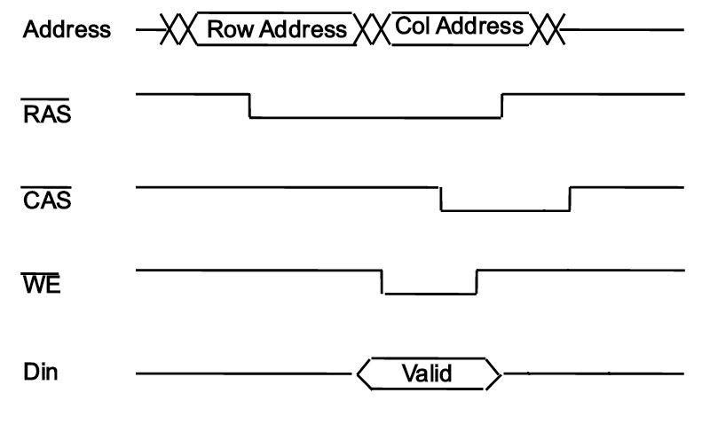
Case studies in Sequential Logic Design
Memory controller
Dynamic RAM
RAS/CAS sequencing for a memory write

Slide 51
FSM Design Examples
Example 1
Scenario A: FSM design from scratch
Scenario B: Utilizing design patterns
Example 2: Design Reuse
Complex counter design by reusing an existing counter
Example 3: Data path + control path
State encoding to simplify control signal generation
Example 4: Memory controller design
Understanding memory architecture and operation details
How to generate pulses at desired time and period?
Memory controller example in detail
Example 5: Multiplier design
Simplifying control logic by modifying data path
Example 6: Serial communication design
Key board → RS232 cable → Display
Designing multiple FSMs running in parallel

Slide 52
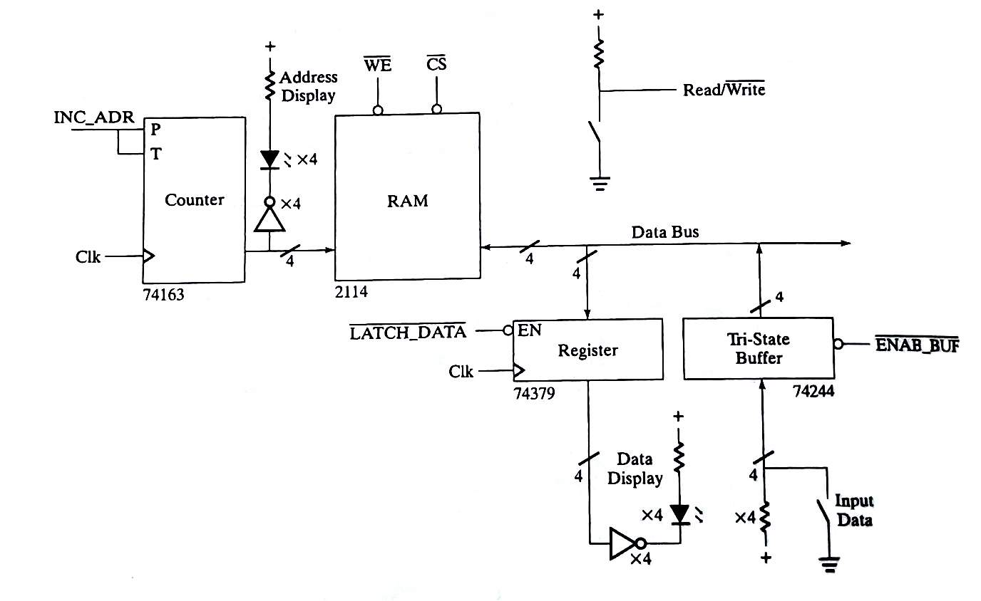

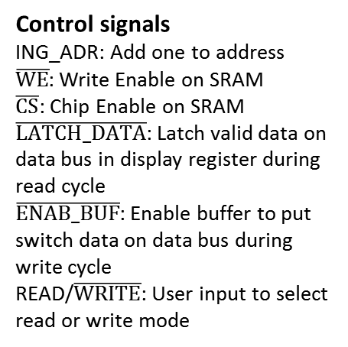
Case studies in Sequential Logic Design
Memory controller
Design of a Simple Memory Controller
Memory Subsystem Data Path
Control signals
ING_ADR: Add one to address
$\overline{WE}$: Write Enable on SRAM
$\overline{CS}$: Chip Enable on SRAM
$\overline{LATCH_DATA}$: Latch valid data on data bus in display register during read cycle
$\overline{ENAB_BUF}$: Enable buffer to put switch data on data bus during write cycle
READ/$\overline{WRITE}$: User input to select read or write mode

Slide 53

Case studies in Sequential Logic Design
Memory controller
Design of a Simple Memory Controller
Schematic

Slide 54


Case studies in Sequential Logic Design
Memory controller
Design of a Simple Memory Controller
Generation of control signals from overlapping clocks, φ₁, φ₂, φ₃ and φ₄

Slide 55
Case studies in Sequential Logic Design
Memory controller
Design of a Simple Memory Controller
Multi-phase clock for sequencer
φ1
φ2
φ3
φ4
IN
D
Q
D
Q
D
Q
D
Q
CLK
IN
φ1
φ2
φ3
φ4
Time
C = φ1φ2φ3’φ4’+φ1’φ2’φ3’φ4

Slide 56
Case studies in Sequential Logic Design
Memory controller
Design of a Simple Memory Controller
Generation of control signals from overlapping clocks, φ₁, φ₂, φ₃ and φ₄
Φ1 Φ2 R/W

Slide 57
Case studies in Sequential Logic Design
Memory controller
Design of a Simple Memory Controller
Generation of control signals from overlapping clocks, φ₁, φ₂, φ₃ and φ₄

Slide 58
FSM Design Examples
Example 1
Scenario A: FSM design from scratch
Scenario B: Utilizing design patterns
Example 2: Design Reuse
Complex counter design by reusing an existing counter
Example 3: Data path + control path
State encoding to simplify control signal generation
Example 4: Memory controller design
Understanding memory architecture and operation details
How to generate pulses at desired time and period?
Memory controller example in detail
Example 5: Multiplier design
Simplifying control logic by modifying data path
Example 6: Serial communication design
Key board → RS232 cable → Display
Designing multiple FSMs running in parallel

Slide 59
Case studies in Sequential Logic Design
Sequential Multiplier v1
An 8-bit multiplier have two 8-bit inputs, the multiplier and multiplicand
Multiplier and multiplicand are already loaded in two registers
Multiplier computes the 16-bit product within approximately 8 clock cycle,
and leave the result in another register
Example)
1 1 0 1
X 1 0 1 1
1 1 0 1
1 1 0 1
1 1 0 1
1 0 0 0 1 1 1 1
Multiplicand
Multiplier
for every clock edge
tmp = Product + Multiplicand;
if Multiplier[0]==1
Product=tmp;
Multiplier=Multiplier>>1;
Multiplicand=Multiplicand<<1;
Product
At every clock edge, the following actions take places in parallel:
Adds the current multiplicand to the (partial) product
Product register loads the next partial product (existing or new one)
Multiplier is shifted one bit to the right (divided by 2)
Multiplicand is shifted one bit to the left (multiplied by 2)

Slide 60


Case studies in Sequential Logic Design
Sequential Multiplier v1
Block diagram
8
Load1
‘0’
Multiplier
Digit
8
8
Multiplicand
Shift
‘0’
Load2
clock
Start
Digit
16
16
Accumulator
Control
tmp
16
Clear
Product
Load3
16
for every clock edge
tmp = Product + Multiplicand;
if Multiplier[0]==1
Product=tmp;
Multiplier=Multiplier>>1;
Multiplicand=Multiplicand<<1;
Shift
Clear
Load3

Slide 61

Case studies in Sequential Logic Design
Sequential Multiplier v1
State diagram
Start / Clear
Reset
idle
S0
S1
S2
S3
S4
Digit / Load3,Shift
Digit’ / Shift
Start’
S7
S6
S5

Slide 62
Case studies in Sequential Logic Design
Sequential Multiplier v2
By adding a bit more combinational logic to our implementation,
We can make our multiplier FSM much simpler
Example)
1 1 0 1
X 1 0 1 1
1 1 0 1
1 1 0 1
0 0 0 0
1 1 0 1
1 0 0 0 1 1 1 1
Multiplicand
Multiplier
Product
for every clock edge
tmp = Multiplicand & Multiplier[0];
Product = Product + tmp;
Multiplier=Multiplier>>1;
Multiplicand=Multiplicand<<1;

Slide 63
Case studies in Sequential Logic Design
Sequential Multiplier v2
Block diagram
8
Load1
‘0’
Multiplier
Digit
4
8
Load3-Shift
Multiplicand
‘0’
Load2
16
Pass/Zero’
clock
Start
Pass or Zero
16
16
Control
Accumulator
16
Clear
Product
16
Load3-shift
Load3-Shift
Clear

Slide 64
Case studies in Sequential Logic Design
Sequential Multiplier v2
for every clock edge
tmp = Multiplicand & Multiplier[0];
Product = Product + tmp;
Multiplier=Multiplier>>1;
Multiplicand=Multiplicand<<1;
Block diagram
8
Load1
‘0’
Multiplier
Digit
4
8
Load3-Shift
Multiplicand
‘0’
Load2
16
Pass/Zero’
clock
Start
Pass or Zero
tmp
16
16
Control
Accumulator
16
Clear
Product
16
Load3-shift
Load3-Shift
Clear

Slide 65
Case studies in Sequential Logic Design
Sequential Multiplier v2
State diagram
Start / Clear
Reset
idle
S0
S1
S2
S3
S4
Start’
Load3-Shift
S7
S6
S5
Current State Start
Idle 0000 0
Idle 0000 1
S0 1000 -
S1 1001 -
S2 1010 -
S3 1011 -
S4 1100 -
S5 1101 -
S6 1110 -
S7 1111 -
Next State Clear Load3-Shift
0000 Idle 0 0
1000 S0 0 0
1001 S1 0 1
1010 S2 0 1
1011 S3 0 1
1100 S4 0 1
1101 S5 0 1
1110 S6 0 1
1111 S7 0 1
0000 Idle 0 0

Slide 66
FSM Design Examples
Example 1
Scenario A: FSM design from scratch
Scenario B: Utilizing design patterns
Example 2: Design Reuse
Complex counter design by reusing an existing counter
Example 3: Data path + control path
State encoding to simplify control signal generation
Example 4: Memory controller design
Understanding memory architecture and operation details
How to generate pulses at desired time and period?
Memory controller example in detail
Example 5: Multiplier design
Simplifying control logic by modifying data path
Example 6: Serial communication design
Key board → RS232 cable → Display
Designing multiple FSMs running in parallel

Slide 67
Making connections
Direct point-to-point connections between gates
wires we've seen so far
Route one of many inputs to a single output - multiplexer (MUX)
Route a single input to one of many outputs - demultiplexer (DEMUX)
control
control
multiplexer
demultiplexer
4x4 switch
Two popular regular logic components are MUX and DEMUX. A MUX selects one of its data inputs to the output by the control inputs; a MUX is also called a selector. The diagram on the left shows a 4-input MUX. Can you guess the relation between the number of data inputs and the number of control lines? A DEMUX performs the reverse function, often called a decoder. We can clearly see that these components perform higher-level functions compared to logic gates

Slide 68




Case studies in Sequential Logic Design
A Serial Line Transmitter/Receiver
A hardware to communicate over a single wire (using RS-232 serial line protocol)
The data will be sent serially, and the circuit works in general case when the clocks on the two ends are completely asynchronous.
The hardware consists of two circuits.
The first circuit will take input from a telephone-like keypad and send a byte corresponding to the key that was pressed over a single wire one bit at a time.
The second circuit will receive the serial data sent by the first and display it on a small LCD screen.
RS-232 serial line protocol for one byte of data
Quiescent value (normally high)

Slide 69

Case studies in Sequential Logic Design
A Serial Line Transmitter/Receiver
Implementation
Oversampling
It may miss the start bit between two high values if it samples the wire once every bit time.
It needs a faster clock that will sample the wire faster than once every bit cycle (in this case, 4 times during each bit time)
Block diagram of serial line transmitter/receiver

Slide 70

Case studies in Sequential Logic Design
A Serial Line Transmitter/Receiver
Block diagram of serial line transmitter/receiver(Cont’d)
Sender part
Receiver part
KeyboardDecode: Decoding the signals from the keypad and turn them in to the appropriate character code for the button that was pressed
Sender: Taking the byte and serially transmits it over the single wire
Receiver: Observing the signal wire coming from the sender and determines when a byte has been received
DisplayControl: Taking the data and controls the LCD appropriately to get the corresponding character to show up on the screen

Slide 71


Case studies in Sequential Logic Design
A Serial Line Transmitter/Receiver
Keyboard
Schematic diagram of a keyboard block with debouncing circuitry
Schematic diagram of a single keyboard key

Slide 72

Case studies in Sequential Logic Design
A Serial Line Transmitter/Receiver
KeyboardDecode
module KeyboardDecode (ClkS, ResetS, R1, R2, R3, R4, C1,
C2, C3, AckS, Send, CharToSend);
input ClkS, ResetS, R1, R2, R3, R4, C1, C2, C3, AckS;
output Send;
output [7:0] CharToSend;
reg [7:0] CharToSend;
reg Send;
wire KeyPress;
assign KeyPress = (R1 || R2 || R3 || R4) && (C1 || C2 || C3);
always @(posedge ClkS) begin
if (ResetS) begin Send <=0; end
else begin
if (KeyPress && !AckS) begin
if (R1 && C1) CharToSend <= 8'b00110001;
//code for 1
else if (R1 && C2) CharToSend <= 8'b00110010;
//code for 2
else if (R1 && C3) CharToSend <= 8'b00110011;
//code for 3
else if (R2 && C1) CharToSend <= 8'b00110100;
//code for 4
else if (R2 && C2) CharToSend <= 8'b00110101;
//code for 5
else if (R2 && C3) CharToSend <= 8'b00110110;
//code for 6
else if (R3 && C1) CharToSend <= 8'b00110111;
//code for 7
else if (R3 && C2) CharToSend <= 8'b00111000;
//code for 8
else if (R3 && C3) CharToSend <= 8'b00111001;
//code for 9
else if (R4 && C1) CharToSend <= 8'b00101010;
//code for *
else if (R4 && C2) CharToSend <= 8'b00110000;
//code for 0
else if (R4 && C3) CharToSend <= 8'b00100011;
//code for #
Send <=1;
end
if (AckS) Send <=0;
end
end
endmodule
Send=1
Send=0
Key
pressed
AckS=1

Slide 73


Case studies in Sequential Logic Design
A Serial Line Transmitter/Receiver
Sender
module Sender (ClkS, ResetS, Send, CharToSend, AckS, TxD);
input ClkS, ResetS, Send;
input [7:0] CharToSend;
output AckS, TxD;
reg TxD; // register alias for RS232 line
reg [7:0] charToSend; // holds character to be sent over
// the serial line
reg [3:0] bitCounter; // keeps count of which bit is
// being sent
reg go;
always @(posedge ClkS) begin
if (ResetS) begin TxD <= 1; go <= 0; end
else begin
if (Send) begin
// load character sent from keypad and hold
// it just in case
// reset bitCounter to zero for start of new
// transmission and set the go bit
charToSend <= CharToSend;
bitCounter <= 0; go <= 1;
end
else begin
bitCounter <= bitCounter + 1;
// if go is set, it's time to send the
// next bit of the 10 to be sent -
// start bit, 8 bits of character to send
// (most significant bit first),
// and a stop bit at the end - reset go when done
if (go) begin
if (bitCounter == 0) TxD <= 0;
else if (bitCounter > 0 && bitCounter <= 8)
TxD <= charToSend[8 - bitCounter];
else if (bitCounter > 8) begin
TxD <= 1;
go <= 0;
end
end
end
end
end
assign AckS = go;
endmodule
ClkS
ResetS
Send=1
Send=0
Key
pressed
AckS=1

Slide 74

Case studies in Sequential Logic Design
A Serial Line Transmitter/Receiver
Sender
module Sender (ClkS, ResetS, Send, CharToSend, AckS, TxD);
input ClkS, ResetS, Send;
input [7:0] CharToSend;
output AckS, TxD;
reg TxD; // register alias for RS232 line
reg [7:0] charToSend; // holds character to be sent over
// the serial line
reg [3:0] bitCounter; // keeps count of which bit is
// being sent
reg go;
always @(posedge ClkS) begin
if (ResetS) begin TxD <= 1; go <= 0; end
else begin
if (Send) begin
// load character sent from keypad and hold
// it just in case
// reset bitCounter to zero for start of new
// transmission and set the go bit
charToSend <= CharToSend;
bitCounter <= 0; go <= 1;
end
else begin
bitCounter <= bitCounter + 1;
// if go is set, it's time to send the
// next bit of the 10 to be sent -
// start bit, 8 bits of character to send
// (most significant bit first),
// and a stop bit at the end - reset go when done
if (go) begin
if (bitCounter == 0) TxD <= 0;
else if (bitCounter > 0 && bitCounter <= 8)
TxD <= charToSend[8 - bitCounter];
else if (bitCounter > 8) begin
TxD <= 1;
go <= 0;
end
end
end
end
end
assign AckS = go;
endmodule
Send=1
Send=0
Key
pressed
AckS=1
TxD=0
D7
D6 ….

Slide 75
Case studies in Sequential Logic Design
A Serial Line Transmitter/Receiver
Block diagram of serial line transmitter/receiver(Cont’d)
Sender part
Receiver part
KeyboardDecode: Decoding the signals from the keypad and turn them in to the appropriate character code for the button that was pressed
Sender: Taking the byte and serially transmits it over the single wire
Receiver: Observing the signal wire coming from the sender and determines when a byte has been received
DisplayControl: Taking the data and controls the LCD appropriately to get the corresponding character to show up on the screen

Slide 76

Case studies in Sequential Logic Design
A Serial Line Transmitter/Receiver
Receiver
module Receiver (ClkR, ResetR, RxD, AckR, CharRcvd, Rcvd);
input ClkR, ResetR, RxD, AckR;
output [7:0] CharRcvd;
output Rcvd;
reg [4:0] bitCounter; // keep count of number of bits received
reg [1:0] cycleCounter; // used to divide input clock by 4
reg [8:0] characterReceived; // start bit plus 8 data bits
reg go; // flag indicating a character is arriving
// finite state machine to receive characters
always @(posedge ClkR) begin
if (ResetR) begin go <= 0; Rcvd <= 0; end
else begin
if (!go && !Rcvd && !AckR && RxD) ;
//serial line is still quiet, nothing to do
if (!go && !Rcvd && !AckR && !RxD) begin
//found a start bit, reset the counters
go <=1; bitCounter <= 0; cycleCounter <= 0;
end
if (go) begin // every four cycles . . .
if (cycleCounter == 0) begin
// copy sample into character bit array
characterReceived[8 - bitCounter] <= RxD;
// if the counter has not reached 8,
// increment it
if (bitCounter < 8)
bitCounter <= bitCounter + 1;
else begin
// otherwise, signal that the entire character has been received by
// starting handshake and resetting
// counter and flag
go <= 0;
Rcvd <= 1;
end
end
cycleCounter <= cycleCounter + 1;
// increment counter
end
if (AckR) Rcvd <= 0;
// complete four cycle
// handshake with DisplayControl
end
end
// connect the CharRcvd lines to the character received
// ignoring the start bit
assign CharRcvd[7:0] = characterReceived[7:0];
endmodule
1
RxD
cycleCounter
0
1
2
3
0
Rcvd=1

Slide 77

Case studies in Sequential Logic Design
A Serial Line Transmitter/Receiver
Display
Operation | RS | DB7 . . . DB0
Clear display | 0 | 0000 0001
Function set | 0 | 0011 0011
Display on | 0 | 0000 1100
Entry mode set | 0 | 0000 0110
Write character | 1 | DDDD DDDD
Timing of LCD screen interface
LCD screen operations

Slide 78
Case studies in Sequential Logic Design
A Serial Line Transmitter/Receiver
DisplayControl
module DisplayControl (ClkR, ResetR, Rcvd, CharRcvd,
AckR, DB, RS, Enable);
input ClkR, ResetR, Rcvd;
input [7:0] CharRcvd;
output AckR, RS, Enable;
output [7:0] DB;
reg [7:0] databus; // internal databus that can
// be connected to DB lines
reg Enable; // register aliasing for
// LCD screen E signal
reg RS; // register aliasing for
//screen RS signal
reg AckR; // signal to Rcvr module to
// clear its Rcvd output
// this implements a four-cycle
// handshake with Rcvd
reg initMode; // indicates whether the initialize
// sequence is in progress
reg [4:0] initState; // states for initialization sequence
parameter start = 0;
parameter step1 = 1;
parameter endstep1 = 2;
parameter step2 = 3;
parameter endstep2 = 4;
parameter step3 = 5;
parameter endstep3 = 6;
parameter step4 = 7;
parameter endstep4 = 8;
parameter final = 9;
// drive DB lines from internal databus during
// initialization sequence
// or from CharRcvd register when displaying characters
assign DB = (initMode) ? databus : CharRcvd;

Slide 79
Case studies in Sequential Logic Design
A Serial Line Transmitter/Receiver
DisplayControl(Cont’d)
always @(posedge ClkR) begin
if (ResetR) begin initMode <= 1; initState <= start;
Enable <= 0; AckR <= 0; end
else if (initMode) begin
// do initialization sequence
case (initState)
start: // set display to receive commands
begin RS <= 0; initState <= step1; end
step1: // 1st step of initialization
// sequence - clear display
begin Enable <= 1; databus <= 8'b00000001;
initState <= endstep1; end
endstep1:
begin Enable <= 0; initState <= step2; end
step2: // 2nd step of initialization sequence -
// function set
begin Enable <= 1; databus <= 8'b00110011;
initState <= endstep2; end
endstep2:
begin Enable <= 0; initState <= step3; end
step3: // 3rd step of initialization sequence -
// display on
begin Enable <= 1; databus <= 8'b00001100;
initState <= endstep3; end
endstep3:
begin Enable <= 0; initState <= step4; end
step4: // 4th step of initialization sequence -
// entry mode set
begin Enable <= 1; databus <= 8'b00000110;
initState <= endstep4; end
endstep4:
begin Enable <= 0; initState <= final; end
final:
begin
RS <= 1; // Set display to
// receive characters
initMode <= 0; // indicate initialize
// completed
initState <= final; // stay in this state
// until next reset
end
endcase
end
else begin
// or see if character has been received
if (Rcvd && !AckR) begin
// character has been received by Receiver module
// display character on display
// begin handshake with Receiver module by
// raising AckR
case (Enable)
0: begin Enable <= 1; end
1: begin Enable <= 0; AckR <= 1; end
endcase
end
else begin
// complete handshake with Receiver module by
// lowering AckR
// after Rcvd is lowered
if (!Rcvd) AckR <= 0;
end
end
end
endmodule
(1)
(2)
(3)
(1)
(2)
(3)

Slide 80
Case studies in Sequential Logic Design
A Serial Line Transmitter/Receiver
Block diagram of serial line transmitter/receiver(Cont’d)
Sender part
Receiver part
KeyboardDecode: Decoding the signals from the keypad and turn them in to the appropriate character code for the button that was pressed
Sender: Taking the byte and serially transmits it over the single wire
Receiver: Observing the signal wire coming from the sender and determines when a byte has been received
DisplayControl: Taking the data and controls the LCD appropriately to get the corresponding character to show up on the screen

Slide 81
FSM Design Examples
Example 1
Scenario A: FSM design from scratch
Scenario B: Utilizing design patterns
Example 2: Design Reuse
Complex counter design by reusing an existing counter
Example 3: Data path + control path
State encoding to simplify control signal generation
Example 4: Memory controller design
Understanding memory architecture and operation details
How to generate pulses at desired time and period?
Memory controller example in detail
Example 5: Multiplier design
Simplifying control logic by modifying data path
Example 6: Serial communication design
Key board → RS232 cable → Display
Designing multiple FSMs running in parallel

Slide 82
Schedule

